Slide 1

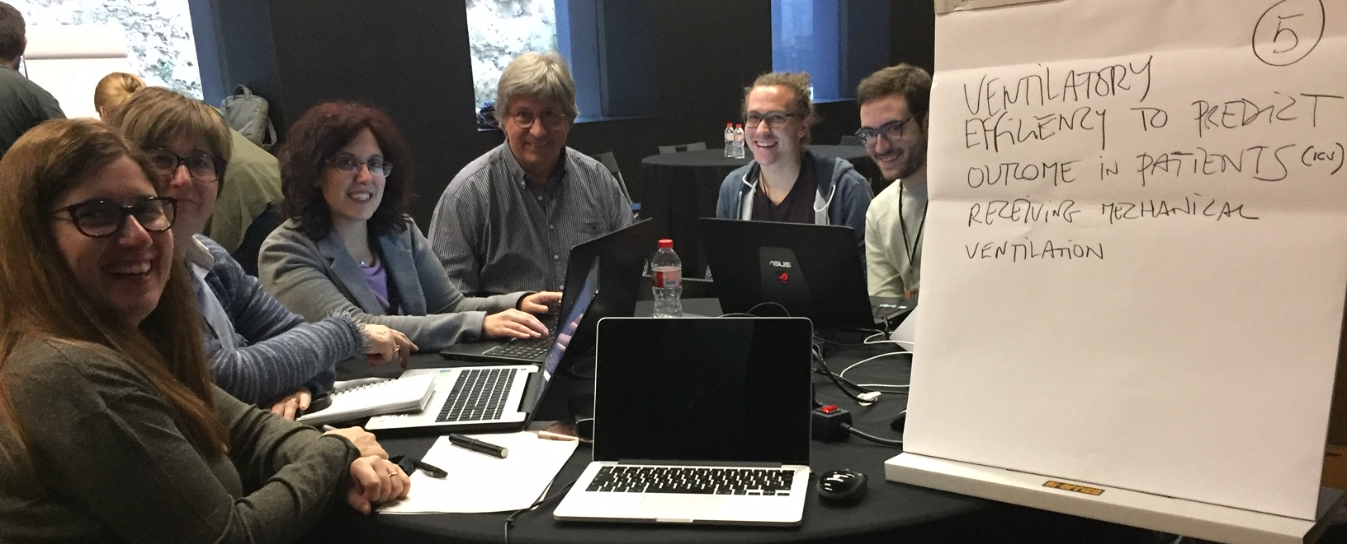
The Team !!
Teresa Rozza¹, Cristina Fortià¹, Lidia Martí Hereu¹, Jordi Escude², Sebastian Karg³, Lluis Blanch¹, Ana Ochagavia¹
¹ Clinician Parc Tauli University Hospital. I³PT
² Data Scientist. University of Barcelona
³ Data Scientist. University Politecnica of Catalonia

Slide 2
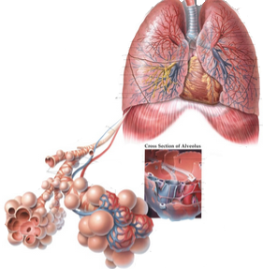
Physiology of respiratory system
Oxigenation
PaO2/FiO2
Ventilation
Vd/Vt
VR

Slide 3
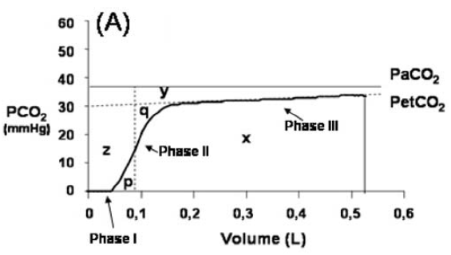
Evaluating dead space

Slide 4
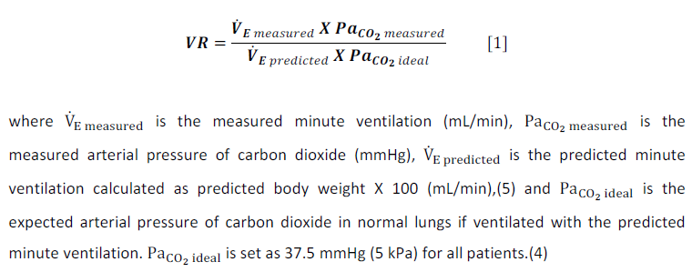
Evaluating ventilatory efficiency (VR)

Slide 5
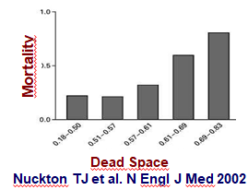
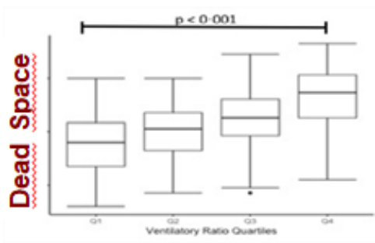
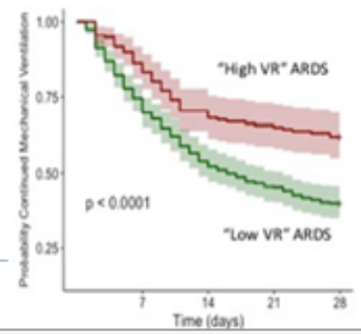

In ARDS
Pulmonary dead space fraction as an independent predictor of mortality
Ventilatory Ratio was found to have significantly association with pulmonary dead space fraction and to be independently associated with increased risk of mortality

Slide 6
Study design
RATIONALE: Critically ill patients under mechanical ventilation may have different functional alterations others than ARDS
HYPOTESIS: Since lung injury impairs ventilatory efficiency, alterations in ventilatory index might be associated to different prognostic indicators
OBJECTIVE: To define mortality using a model that includes age, VR, PaFi, SOFA

Slide 7
Materials and methods
Data for this study was extracted from MIMIC-III. We select 8.000 patients older than 18-years-old with mechanical ventilation and we collect demographics, severity score, hemodinamic and respiratory variable at first day.
We perform a statistical analysis using multivariate analysis, with IC at 95% using R.

Slide 8
Results
 | OR
Age | 0,0243 | 0.0167 | 0.0351
Gender (M) | 0.8658 | 0.7395 | 1.0144
ICU stay | 0.9932 | 0.9850 | 1.0011
PaFi | 0.9016 | 0.8391 | 0.9670
SOFA | 1.2951 | 1.2657 | 1.3255
VR | 1.0480 | 1.0003 | 1.1041

Slide 9
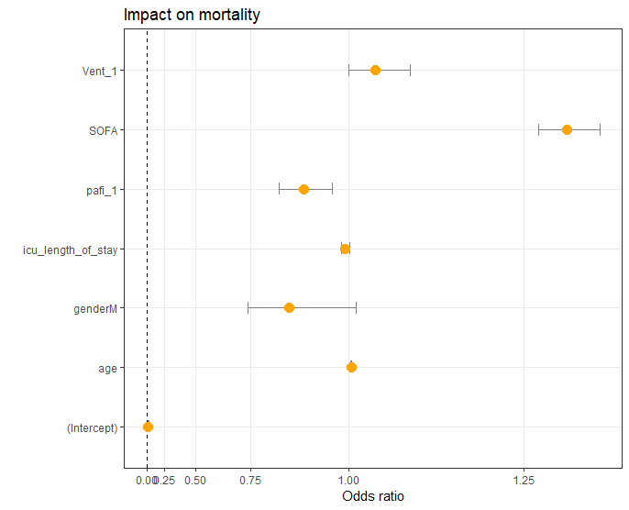
Results II

Slide 10
Conclusions
VR is a new physiological marker that predict outcome in all patients under mechanical ventilation

Slide 11
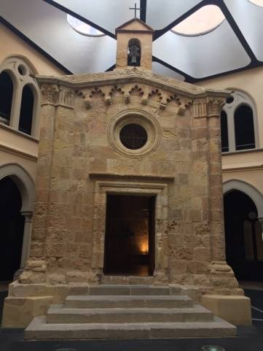

Thank you!!!

